Slide 1
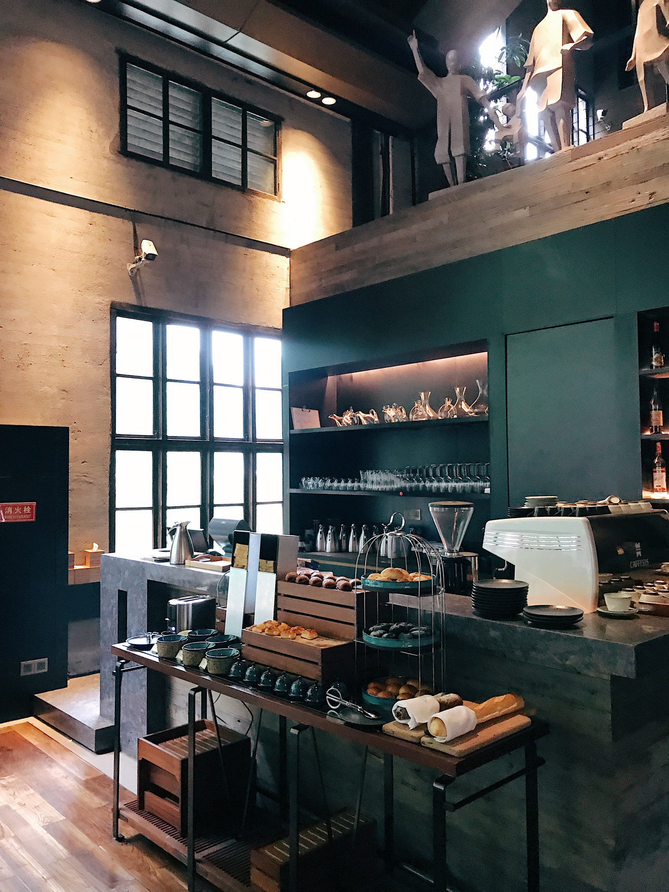
01
Bright
COFFEE SHOP ANALYSIS
WHERE EVERY CUP TELLS A STORY
Coffee Shop analysis for the CEO, investor, and senior stakeholder. It focuses on financial health, market positioning, operational risks, and growth opportunities.
Presented by Regis Yala

Slide 2
...
Bright Shop
Introduction
Data Systems
Analysis
Recommendations
Implementation plan
Q&A
ABOUT US

Slide 3
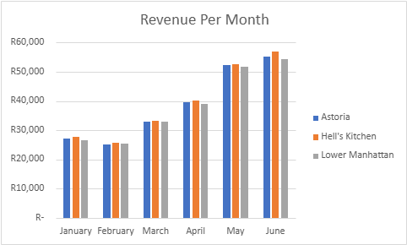
Revenue Analysis| Store location & Month
Insight : Revenue accross all the stores increases by 50% in the month of June as compared to January

Slide 4
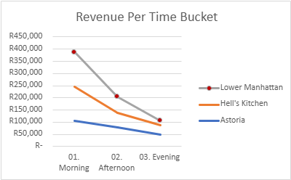
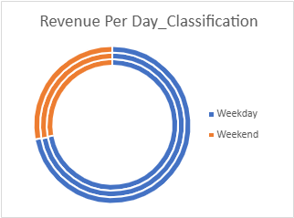
Insight: Morning sales contribution 56 % of the sales followed by afternoon
Revenue Analysis| Time of day

